Slide 1

SYNTHESIS, CHARACTERIZATION, AND THERMAL STABILITY ANALYSIS OF OXIDATIVELY DEGRADABLE POLYUREA
Mst.Rukaya Kusum
Exam roll : 24
Batch :48
Department Of Chemistry
University Of Barishal

Slide 2
Waste Management Problem
Waste management problem has become the topmost problem in modern time. Around the world, waste generation rates are rising.
In 2020, the world was estimated to generate 2.24 billion tons of solid waste, amounting to a footprint of 0.79 kilograms per person per day. With rapid population growth and urbanization, annual waste generation is expected to increase by 73% from 2020 levels to 3.88 billion tons in 2050.¹
Plastic occupies an important part in the solid waste materials.
1. https://www.worldbank.org/en/topic/urbandevelopment/brief/solid-waste-management

Slide 3
From the 1950s to the 1970s, only a small amount of plastic was produced, and as a result, plastic waste was relatively manageable. However between the 1970s and the 1990s, plastic waste generation more than tripled, reflecting a similar rise in plastic production. In the early 2000s, the amount of plastic waste we generated rose more in a single decade than it had in the previous 40 years. The United Nations says 400 million tons of plastic is produced every year, and that figure is set to double by 2040.²
Between 1950 and 2015, 8300 million metric tons of plastics have been produced, in which only 500 million metric tons were recycled.³
2. https://www.unep.org/interactives/beat-plastic-pollution

Slide 4
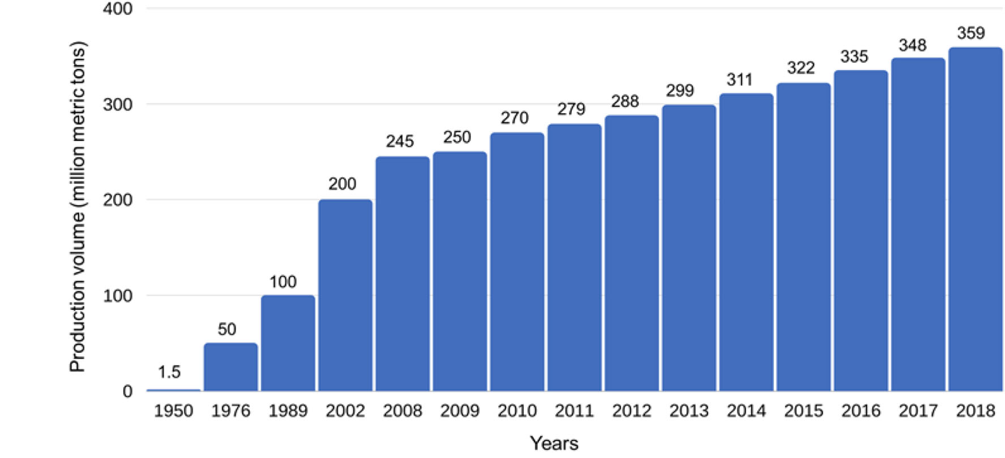
Figure 1: Production of plastics worldwide from 1950 to 2018 (in million metric tons)³
3. Shanmugam, V., Das, O., Neisiany, R. E., Babu, K., Singh, S., Hedenqvist, M. S., ... & Ramakrishna, S. (2020). Polymer recycling in additive manufacturing: an opportunity for the circular economy. Materials Circular Economy, 2(1), 1-11.

Slide 5
Marine pollution
The ocean is said to be Earth’s life support, with 97% of the world’s water held by the ocean. We rely on it to regulate our climate, absorb CO2 and it is the number one source for protein for over a billion people.
However, at the rate we are polluting the ocean with around 12.7 million tons of plastic a year, the damage we are doing to marine life and our ecosystem is becoming irreparable. Our actions over the 10 years will determine the state of the ocean for the next 10,000 years to come.

Slide 6
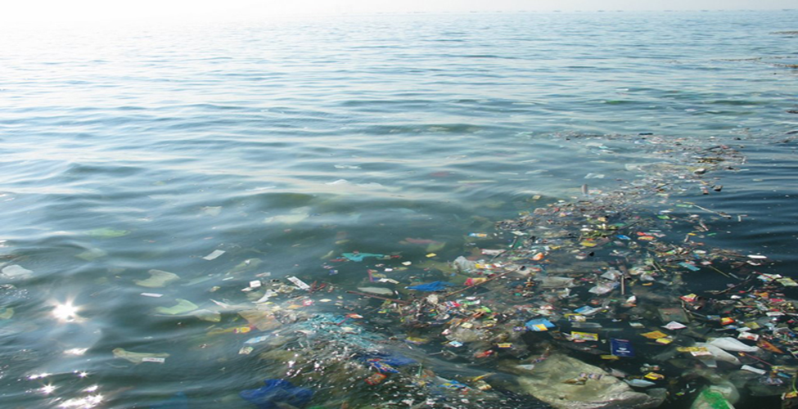

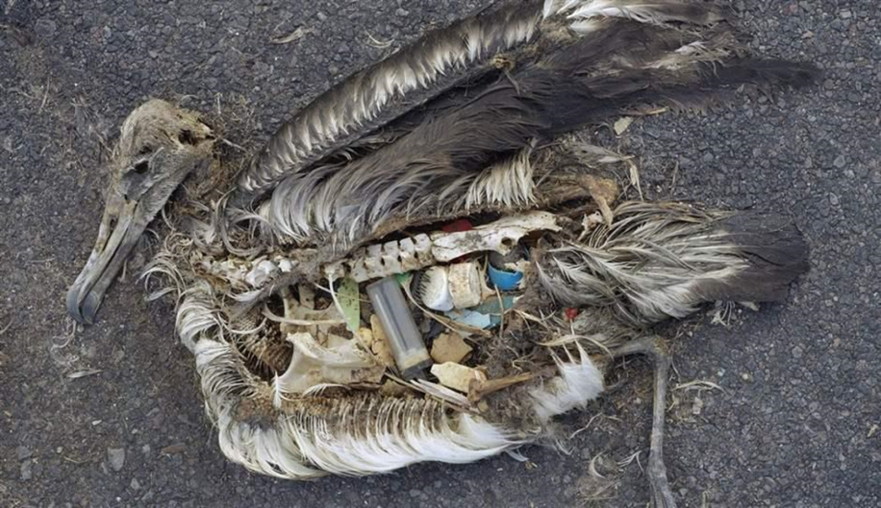

Plastic Pollution
Figure 1: Some common scenarios of plastic pollution

Slide 7
How to sort this problem out?
By reducing use of plastic.
By using bio-degradable polymer.
By using oxydatively degradable polymer.

Slide 8
What if we start using biodegradable plastic materials?
Biodegradable polymers and biomaterials such as wood and paper are degradable during use via rot or mould. That is why biodegradable polymers are not suitable in dietary, sanitary, medical and related applications. Biodegradable polymers are useful only for applications where the plastic material is placed in the field and will never be collected back. For example, ground sheets for agriculture should be made of biodegradable polymers. However, if the plastic material is disposed of in the bin after use (as anyone do), or if the plastic products are collected after use, it is not necessary to be biodegradable. Moreover, if a plastic material is made of biodegradable polymer, people may start disposing of plastic waste outside of the bin. This situation would be very serious.

Slide 9
What to do to solve this existing problem?
Polymer which are not degraded in the environment but can be degraded by oxidizing agent such as sodium hypochlorite may offer an excellent solution of the existing problem of management of polymeric waste materials. This type of polymers are called oxidatively degradable polymer.

Slide 10
Polydiacyl Hydrazine: An Oxidatively Degradable Polymer
Poly(diacylhydrazine) (PDAH), a polyamide for which hydrazine is the diamine component, is a novel degradable polymer that decomposes through the action of an oxidant such as sodium hypochlorite solution^{4,5} (Scheme 1). The poly(diacylhydrazine) decomposes on treatment with an oxidant such as sodium hypochlorite solution to obtain the corresponding carboxylic acid and nitrogen. PDAH is stable in air even at high temperatures (T_{d} is above 320 ℃ in air and no T_{g} is observed below T_{d}).
Scheme 1: Oxidative degradation of polydiacylhydrazine
4. Kihara, N., Ii, R., & Ogawa, A. (2007). Synthesis and properties of nylon‐0, 2–oxidatively degradable polymer that is stable in air. Journal of Polymer Science Part A: Polymer Chemistry, 45(5), 963-967
5. Kihara, N., Iino, Y., & Misawa, T. (2008). Oxidative degradation of poly (isophthaloylhydrazine‐1, 2‐diyl) s. Journal of Polymer Science Part A: Polymer Chemistry, 46(18), 6255-6262

Slide 11
What's on our insight?
Polyester , containing a significant number of ester (-CO-O-) groups, is one of the most used class of polymer. A study has shown that by 2020, global polyester fiber production increased to 57.1 million metric tons⁶. Our aim is to introduce polydiacylhydrazine group in the polymer chain of polyester, so that the produced polymer has the physical properties that of polyesters and at the same time possesses oxidatively degradable properties.
6. https://www.statista.com/statistics/912301/polyester-fiber-production-worldwide/#:~:text=In%201975%2C%20there%20were%20some,to%2057.1%20million%20metric%20tons

Slide 12
Purpose of this work
Polymeric waste in the environment is a matter of deep concern all over the world, as well as in Bangladesh. The main purpose of this research work is to synthesize a thermally stable and oxidatively degradable polymer so as to reduce the polymeric wastes and make the environment free from polymeric wastes.

Slide 13
Objectives of The Research
The main objectives of the research are as follows:
To synthesize bisphenol containing diacylhydrazine moiety as one of the monomer via oxidative coupling.
To synthesize oxidatively degradable polyester.
To characterize the synthesized bisphenol.
To characterize the polymeric bond formation via IR and ¹H-NMR spectrum.
To analyze the thermal stability of the synthesized polymer via T_{g}, DTG and DTA graph of the synthesized polymer.
To check the oxidative degradability of the synthesized polymer in presence of NaClO solution.

Slide 14
Outline of this work
Bisphenol, a monomer, was synthesized by oxidative coupling.
Synthesized bisphenol was then treated with adipoyl chloride, terepthaloyl chloride, and isopthaloyl chloride to produce polyester containing diacylhydrazine moiety.
Different types of polymers was synthesized in different time duration.
IR and NMR analysis was carried out to make confirm the bond formation.
Thermo gravimetric analysis (TGA) was used to study the thermal stability of the synthesized polymers.

Slide 15
Experimental
Materials
Oxone ® (Sigma Aldrich, USA)
4-Hydroxybenzhydrazide (Alfa Aesar, UK 98.0% purity)
Terephthaloyl chloride (Alfa Aesar, UK, 99% purity)
Isophthaloyl dichloride (Alfa Aesar, UK 98% purity)
Adipoyl Chloride (Sigma Aldrich,USA, 98% purity)
N-Methyl-2-pyrrolidone (NMP), (Alfa Aesar, UK, 99% purity)
NaClO
Instruments
Hot Plate Magnetic Stirrer
Suction pump filter
Fourier Transform Infrared Spectrometer
Thermal Gravimetric Analysis

Slide 16
Synthesis of Polymer
Each 10mmol/ 20mmol of 4-aminobenzohydrazide was treated with 1mole equivalent of Oxone in an aqueous medium (250ml/ 500 ml) for about 2 hours at room temperature to produce 4-hydroxy-N'-(4-hydroxybenzoyl)benzohydrazide (1a).
Scheme 2: Synthesis of bisphenol containing diacylhydrazine group by oxidative coupling

Slide 17
Table 1. Percentage yield for the synthesis of monomer 1a
Name | Amount of 4-aminobenzohydrazide (mmol) | Amount of 1a obtained (g) | Yield (%)
1a_1 | 10.0 | 0.612 | 45.0
1a_2 | 10.0 | 0.636 | 46.8
1a_3 | 10.0 | 0.609 | 44.8
1a_4 | 10.0 | 0.602 | 44.3
1a_5 | 20.0 | 1.091 | 40.1
1a_6 | 20.0 | 1.121 | 41.2
1a_7 | 10.0 | 0.596 | 43.8
1a_8 | 10.0 | 0.579 | 42.6
1a_9 | 10.0 | 0.602 | 44.3
1a_10 | 10.0 | 0.596 | 43.8
1a_11 | 10.0 | 0.619 | 45.5

Slide 18
IR Spectral Data of 1a
Figure 2: IR spectrum of 1a
IR: ν= 3395 cm⁻¹(NH stretching), 3285 cm⁻¹ (broad, OH stretching), 1671 cm⁻¹ (CO stretching of diacylhydrazine)

Slide 19
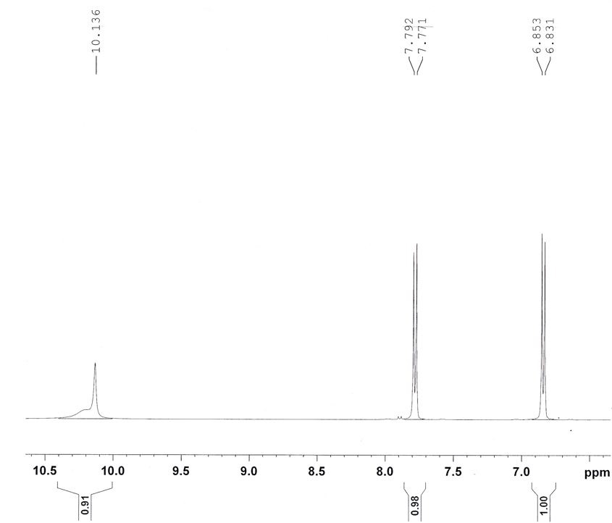
NMR Data of 1a
Figure 3: 1H-NMR spectrum of 1a in DMSO [Zoomed View]
¹H NMR (400MHz, δ ppm, DMSO):10.14 (s, 2H,-OH), 10.13(s, 2H, hydrazide NH proton), 7.78(d, 2H, J=8.4, Ar-H), 6.84 (d, 2H, J=8.8, Ar-H).

Slide 20
Polymer synthesis process
Bisphenol (1a), one of the monomer, was dissolved in NMP.
Then next monomer (either adipoyl chloride, isophthaloyl chloride or terephthaloyl chloride) was added to the solution.
The reaction mixture was stirred at rt for required time period.
The reaction mixture was then mixed with water and the polymer was then collected by filtration.

Slide 21
Table 2: Polymerization conditions and yield of the polymers
Polymer | 1a | Terephthaloyl chloride | Isophthaloyl chloride | Adipoyl chloride | NMP (mL) | Reaction time (h) | Weight of the product (g) | Yield (%)
Polymer 1 | 1.0 mmol (0.272 g) | 1.0 mmol (0.203 g) | X | X | 5 | 24 | 0.354 | 80.6
Polymer 2 | 1.0mmol (0.272 g) | X | 1.0 mmol (0.203 g) | X | 5 | 24 | 0.339 | 77.2
Polymer 3 | 1.0 mmol (0.272 g) | X | X | 1.0 mmol (0.183 g) | 5 | 24 | 0.218 | 52.0
Polymer 4 | 1.0 mmol (0.272 g) | 1.0 mmol (0.203 g) | X | X | 5 | 48 | 0.388 | 88.4
Polymer 5 | 1.0 mmol (0.272 g) | X | 1.0 mmol (0.203 g) | X | 5 | 48 | 0.378 | 86.1
Polymer 6 | 1.0 mmol (0.272 g) | X | X | 1.0 mmol (0.183 g) | 5 | 48 | 0.289 | 69.0

Slide 22
Polymerization reaction
Scheme 3: Polymerization reaction between 4-aminobenzohydrazide and terepthaloyl chloride

Slide 23
Polymerization reaction
Scheme 4: Polymerization reaction between 2-aminobenzohydrazide and isophthaloyl chloride

Slide 24
Polymerization reaction
Scheme 5: Polymerization reaction between 4-aminobenzohydrazide and adipoyl chloride

Slide 25
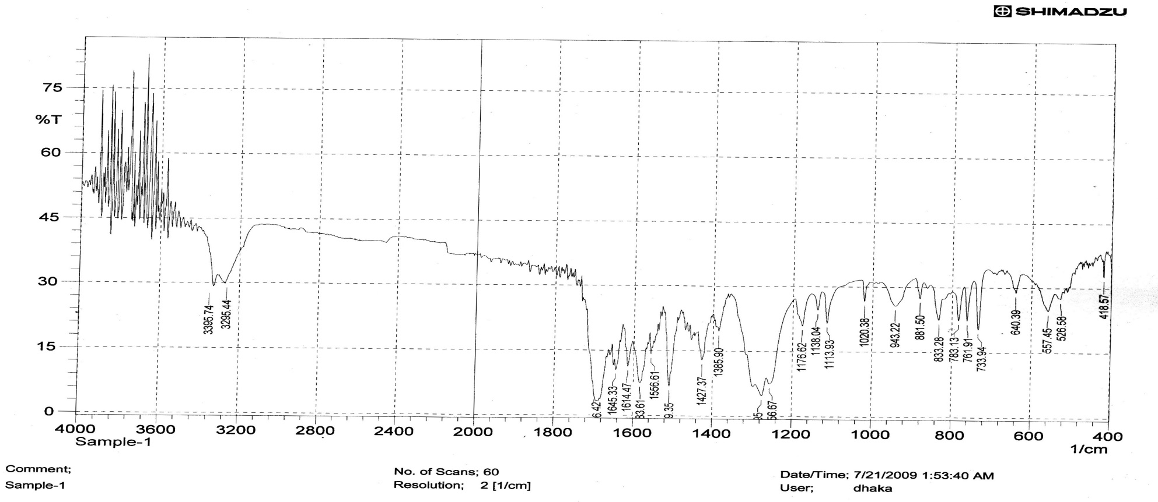
IR Spectral Data of Polymer 1
Figure 4: IR spectrum of Polymer 1
IR: Presence of a peak at 1716 cm⁻¹ confirms the formation of ester bond. Besides some other prominent peaks are: ν = 3396cm⁻¹, 3295cm⁻¹ (asymmetric and symmetric NH stretching respectively), 1645cm⁻¹ (CO stretching of diacylhydrazine)

Slide 26
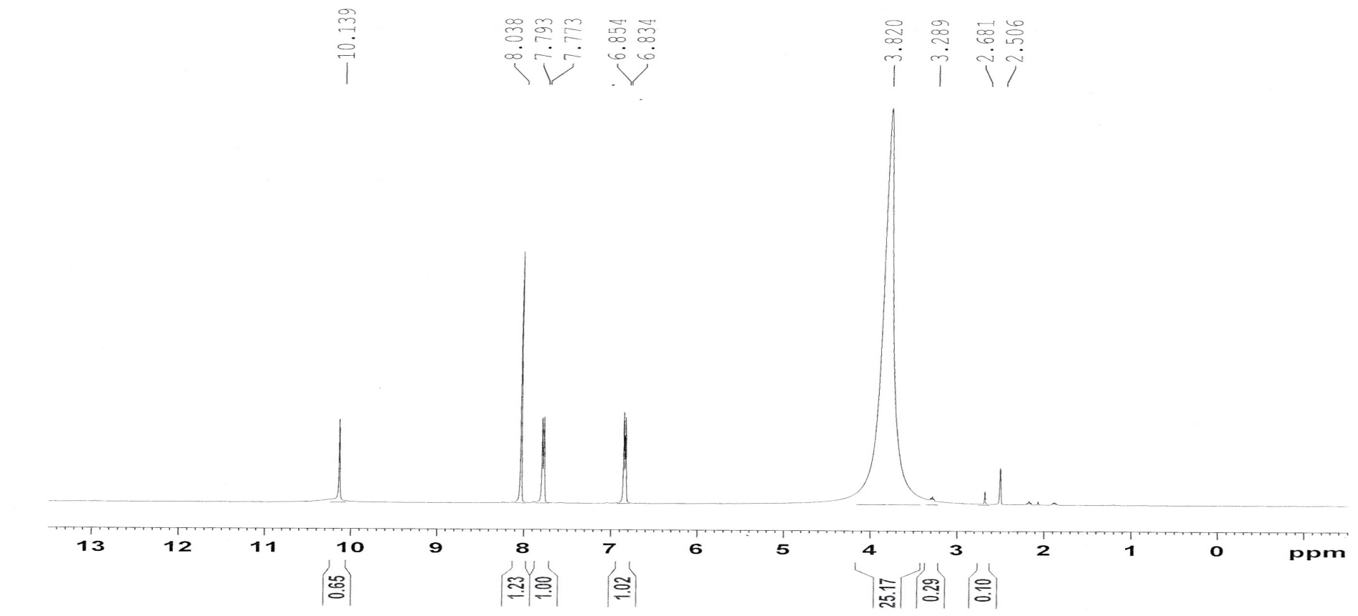
NMR Data of Polymer 1
Figure 5: 1H-NMR spectrum of Polymer 1 in DMSO
¹H NMR (400MHz, δ ppm, DMSO): δ= 10.139 (hydrazide NH proton), 8.04 (Ar-H) 7.78 (Ar-H), 6.84 (Ar-H), 2.18 (-CH2-),1.89 (-CH2-),1.50 (-CH2-).Besides, absence of any peak for phenolic OH indicates the formation of ester bond.

Slide 27
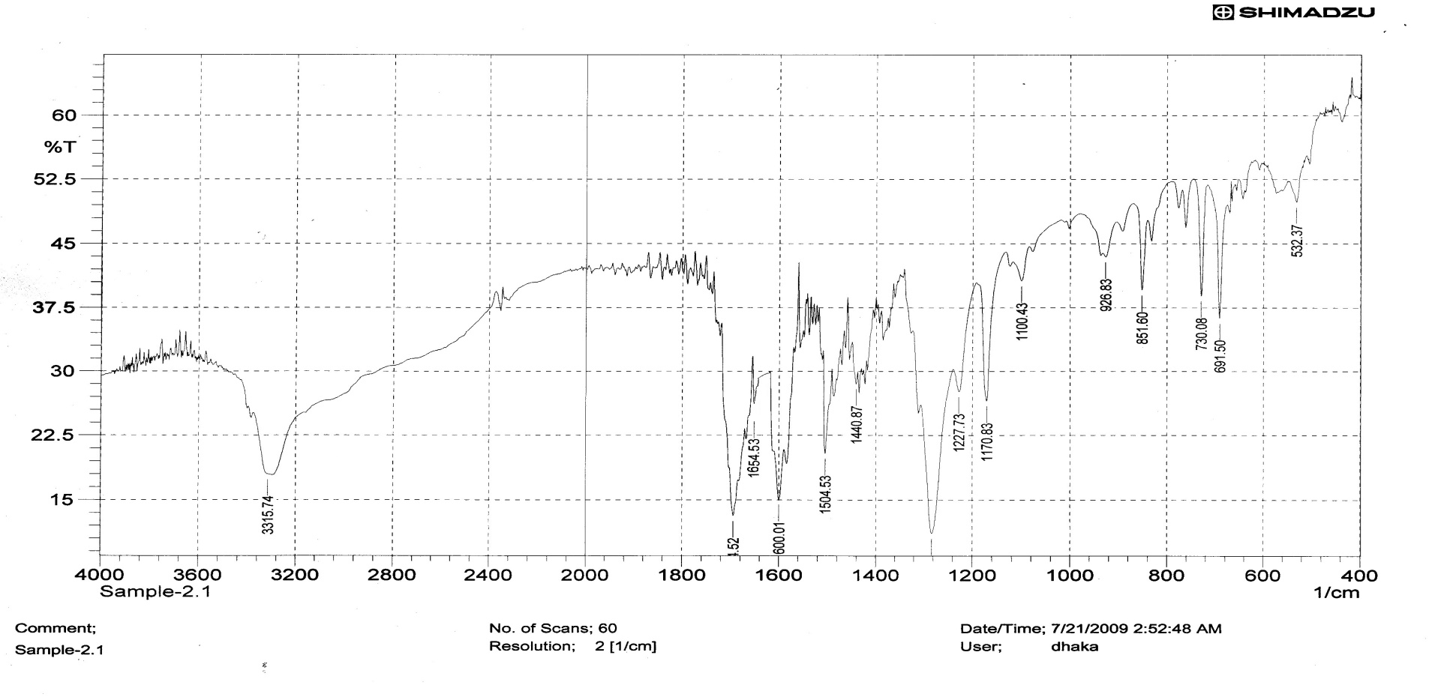
IR Spectral Data of Polymer 2
Figure 6: IR spectrum of Polymer 2
IR: Presence of a peak at 1715 cm⁻¹ confirms the formation of ester bond. Besides some other prominent peaks are : ν = 3316 cm⁻¹ (NH stretching), 1654cm⁻¹ (CO stretching of diacylhydrazine)

Slide 28
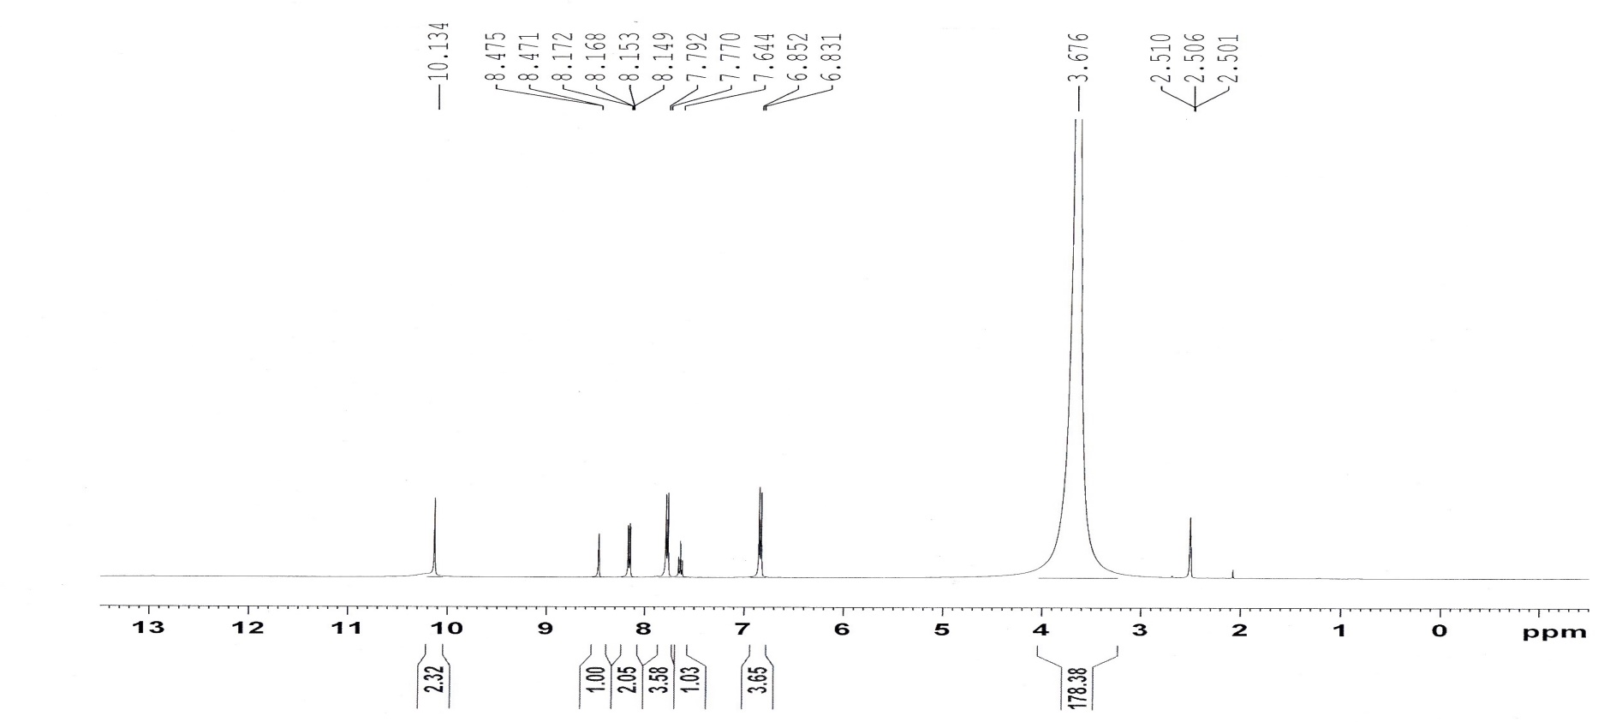
NMR Data of Polymer 2
Figure 7: 1H-NMR spectrum of Polymer 2 in DMSO
¹H NMR (400MHz, δ ppm, DMSO): δ= 10.134 (hydrazide NH proton), 8.47 (Ar-H), 7.78 (Ar-H), 6.84 (Ar-H), 2.18 (-CH2-),1.89 (-CH2-),1.50 (-CH2-). Besides, absence of any peak for phenolic OH indicates the formation of ester bond.

Slide 29
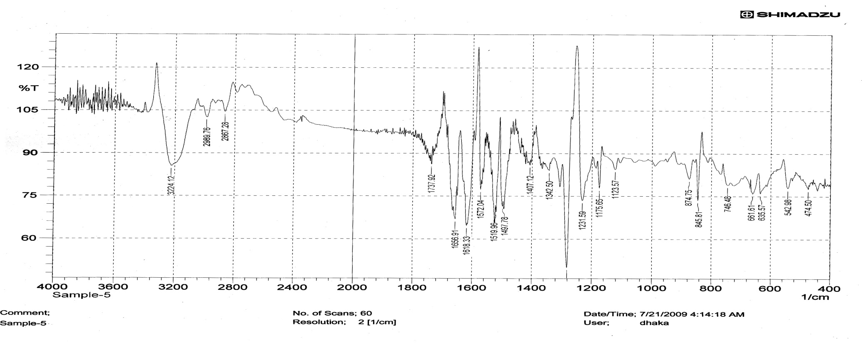
IR Spectral Data of Polymer 3
Figure 8: IR spectrum of Polymer 3
IR: Presence of a peak at 1738cm⁻¹ confirms the formation of ester bond. Besides some other prominent peaks are : ν = 3224 cm⁻¹ (NH stretching), 2990 cm⁻¹, 2867 cm⁻¹ (C-H stretching of methylene group present in one repeating unit coming from adipoyl chloride), 1657 cm⁻¹ (CO stretching of diacylhydrazine).

Slide 30
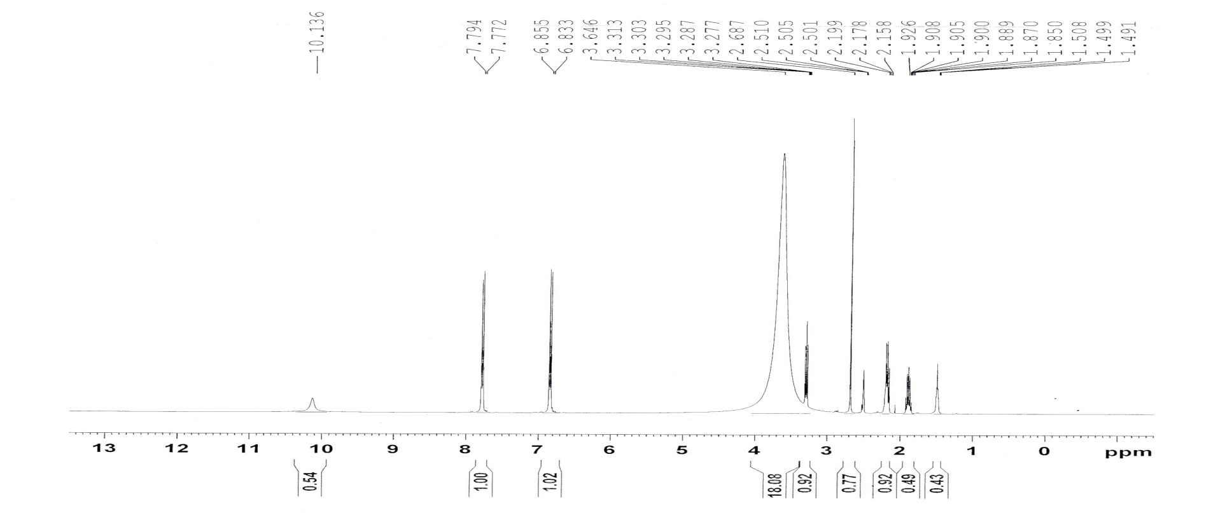
NMR Data of Polymer 3
Figure 9: 1H-NMR spectrum of Polymer 3 in DMSO
¹H NMR (400MHz, δ ppm, DMSO): δ= 10.136 (hydrazide NH proton), 7.78 (Ar-H), 6.84 (Ar-H), 2.18(-CH2-),1.89 (-CH2-), 1.50 (-CH₂-). Besides, absence of any peak for phenolic OH indicates the formation of ester bond.

Slide 31
Thermal Analysis
Figure 10: TG, DTG, and DTA graph of Polymer 1
T_{d} is found to be approximately 271.4 ℃.
No T_{g} and T_{m} is observed below T_{d.}
Rate of decomposition was found to be highest at 327.2 ℃.

Slide 32
Thermal Analysis
Figure 11: TG, DTG, and DTA graph of Polymer 2
T_{d} is found to be approximately 223.7 ℃.
No T_{g} and T_{m} is observed below T_{d.}
Rate of decomposition was highest at 306.0 ℃.

Slide 33
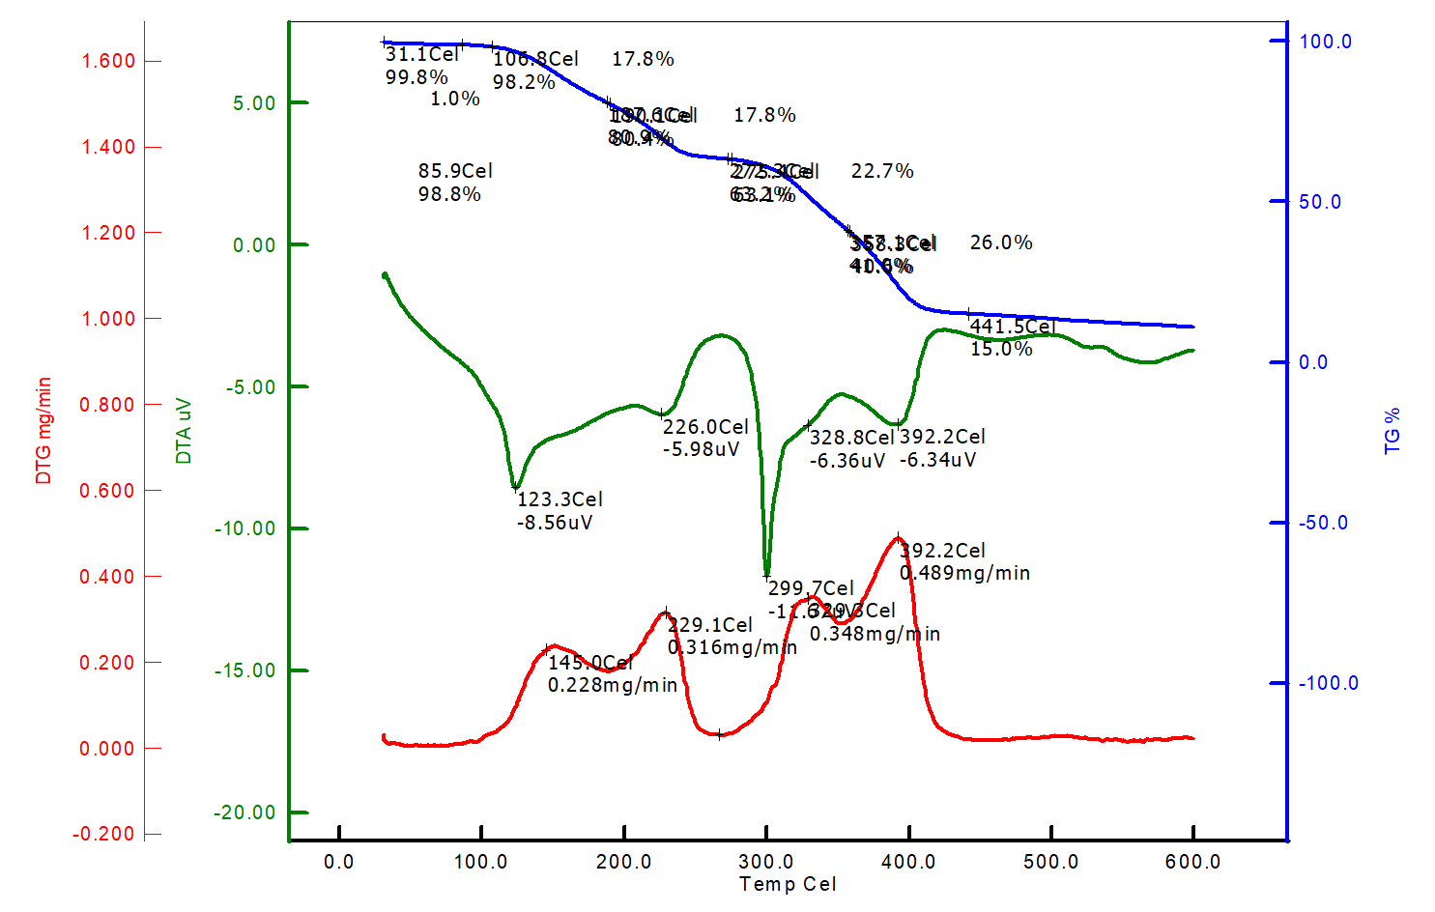
Thermal Analysis
Figure 12: TG, DTG, and DTA graph of Polymer 3
T_{d} is found to be approximately 257.1 ℃..
No T_{g} and T_{m} is observed below T_{d.}
Rate of decomposition was highest at 392.2 ℃.

Slide 34
Solubility of polymer
Table 3: Solubility of synthesized polymer in different solvents
Polymer Name | H₂O | NMP | Methanol | Ethanol | Acetone | H₂SO4 (conc.) | NaOH | NH₃ | Ether
Polymer_1 | X | √ | X | X | X | √ | X | X | X
Polymer_2 | X | √ | X | X | X | √ | X | X | X
Polymer_3 | √ | √ | √ | √ | X | √ | X | X | X
Polymer_4 | X | √ | X | X | X | √ | X | X | X
Polymer_5 | X | √ | X | X | X | √ | X | X | X
Polymer_6 | √ | √ | √ | √ | X | √ | X | X | X
√ = Soluble, X= Insoluble

Slide 35
Reason Behind Low Solubility
Scheme 6: Formation of hydrogen bond between polymer chains

Slide 36
Oxidative Degradation
After stirring the formed polymers in 10 % sodium hypochlorite solution for about five minutes, a clear solution was obtained with the evolution of the bubbles of nitrogen (N₂) gas, confirming the oxidative degradability of the formed polymers. The degradation is attributed due to the following reactions:
Scheme 7: Oxidative degradation process of synthesized polymer.

Slide 37
Conclusion
Different reaction time resulted in different yields of the polymers.
A viscous solution was observed in the reaction time which is an indication of polymer formation.
Polymer shows stability between 220 ℃ to 275 ℃.
No T_{g} and T_{m} is observed below T_{d}.
The rates of the oxidative degradation were different for different polymers.
Synthesized polymer was found to be insoluble in most of the common solvents.
Polymers formed can be degraded by NaClO solution.

Slide 38
Thank You
For
Your Kind
Attention!

